Slide 1
Laptop Security
The proposed system is supposed to secure laptops in higher educational institutions and companies.

Slide 2
Introduction
The system offers a dependable security measure when it come to laptops, data will never be lost. When it comes to systems-related problems, the supporting team is always alert so no need to worry. It also offers good and reliable backup plans and also serves as a notice board for the institution through the memo section in the homepage.

Slide 3
Problem Statement
On December 2008 the Ministry of Defense released on account of high rise of laptop theft (Edward 2009). The research went on further to narrate that the stealing of the laptops is not mainly done at an open air spaces like on the road or a market place but rather where they are used most, that include in schools and working places.

Slide 4
Specific Objectives
-To develop a system that will be platform independence ie can be used in both large and small screen devices.
-To develop a system that will less costly both to the user and the developer.
-To develop a system that will be secure in terms of hacks.
-To develop a system using available resources and knowledge to as to ensure availability of spare parts in case of any irregularity or breakage.

Slide 5
Limitation and Assumption
The study assumes that:
The system users are
1.Computer literate.
2.Understand English.
3.Can type atleats 60 words in a minute.
4.Have some knowledge in SQL.(system admin)

Slide 6
Methodology
Agile software development is an approach to software development under which requirements and solutions evolve through the collaborative effort of self-organizing and cross-functional teams and their customer/end user.

Slide 7
Users of the system
The System will have only two users.
  1.The system admin.
  2.The security personnel.

Slide 8
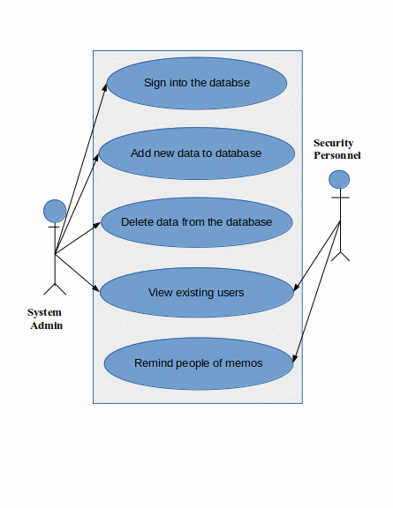
Users of the system

Slide 9
System Development tools
Language to be used will be php.
Front end framework will be bootstrap.
Inkscape free software will be used to edit pictures.
XAMPP free software will be used to hold the database.
Text editors to be used will be Vscode and vim.

